Slide 1
Design Synthesis Exercise
DSE
Workshop PM – SE
2009-2010
Ricky Curran, AMO Michel van Tooren
Rob Hamann SSE Design of Aircraft & Rotorcraft
Aerospace Engineering

Slide 2
Contents
PM/SE workshop, part I
  Project Management
    Introduction
    Why project management
    Project management in the DSE
      Phasing: Start-up vs. Execution
      Basis: The Multi-element Statement of Work
      Methodology: simplified professional PM
        References
        Part 1: Project definition and organization
        Part 2: Project planning
        Part 3: Project control
PM/SE workshop, part II
  Systems Engineering
PM/SE WS-<number>

Slide 3
Introduction: Learning goals DSE
Project Management / Systems Engineering
The student shall be able to
Select and use Systems Engineering methods and tools required to successfully complete a multi-disciplinary product development project
  Based on (customer or market driven) mission and user requirements
  With limited resources and time
Organize and control the project efficiently
Report the resulting design and design choices explicitly and effectively
PM/SE WS-<number>

Slide 4
Introduction: Use of PM/SE workshop for the Design Synthesis Exercise
It operationalizes techniques treated in the course ae3-S01, Systems Engineering & Technical Management Techniques, for the Design Synthesis Exercise, aiming specifically at:
Project Plan
  Mission Need Statement
  Project Objective Statement
  Work flow diagram / D&D logic
  Work Breakdown Structure
  Organogram
  Gantt chart
  Schedule risk assessment
Functional analysis
  Functional flow diagram
  Functional break down
Requirements analysis
  Requirements Discovery Tree
Risk analysis
  Technical Performance Measurement
  Technical risk assessment
Interface identification – N² Chart
Design option analysis
  Design option tree
  Preparing for trade-off and performing it
  Presenting trade-off results
Presenting the design explicitly and effectively
Development logic & cost estimate
PM/SE WS-<number>

Slide 5
PROJECT MANAGEMENT
PM/SE WS-<number>

Slide 6
Why project management (1)
DSE: 10 students 10 weeks of work
= 4000 hrs of design and engineering
‘Market Value’: around 300.000 euro
Which customer wouldn’t like to know in advance what he will get for this amount of money?
PM/SE WS-<number>

Slide 7
Why project management (2)
Necessary professional skills
for
both scientists and engineers
Applied in:
Research projects (EU, NIMR, STW etc.)
Commercial projects
Other activities
PM/SE WS-<number>

Slide 8
Why project management (3)
In acquisition/start-up phase, project plan for:
Risk management: can I deliver what I promise?
Trade-offs: which combination of results, budget and
resources is acceptable/optimal for client
and supplier?
Communication: tell what you are going to do for the money
of your client
Budget
Resources
Results
PM/SE WS-<number>

Slide 9
Why project management (4)
During project execution all:
Risk management: Do we progress as foreseen, where do we
need changes (budget, resources, results)
Trade-offs: which changes in combination of results,
budget and resources is acceptable for
client and supplier?
Control/communication: inform client/management/finance and
team members
Budget
Resources
Results
PM/SE WS-<number>

Slide 10
Why project management (4)
Industry tendency to go to concurrent engineering
So chaos will result without planning
Concurrent engineering
Sequential design
New activities are started before previous step(s) is/are finished: data used is often preliminary and not verified
New activities are started when the previous step(s) is/are finished and verified
Time to market push
PM/SE WS-<number>

Slide 11
Project management in the DSE
In start-up phase:
What should the product do
What should we do
How did we came up with a process flow to get to the required end result?
Project Plan
  MNS, POS
  Work flow diagram / D&D logic
  Work Breakdown Structure
  Organogram
  Gantt chart
How can I divide the work in packages
What organisation do I need to get the work done (for DSE: limited to organisation within the project team)? Who is responsible for what?
How can I divide the work packages in activities that can be assigned to individual team members and how should I organise these tasks in time so I can do all the work with the available resources leading to a result that is acceptable to the customer
PM/SE WS-<number>

Slide 12
Project management in the DSE
In execution phase:
Progress checks (use of roll-up bars in Gantt chart)
Planning updates
  Re-scheduling
  in case of a too sportive/too conservative planning
  unexpected results
  Re-assignment of resources
Increasingly detail planning (e.g. per week/day)
Should be reflected in updated Gantt-sheets
PM/SE WS-<number>

Slide 13
Project management in the DSE
Project plan is based on the:
Mission Need Statement and the Project Objective Statement
In case of the DSE the MNS is mainly predefined. Complication:
different parties want something from the project teams:
The project supplier
The SE-teachers
The ‘presentation’ teachers
The ‘sustainable’ teachers
Etc.
So the POS and the resulting planning are a compromise
PM/SE WS-<number>

Slide 14
Project management in the DSE
Important:
All elements of the POS and the MNS should flow down in the project plan
Remember that there are people that are checking all the assignments and they do not want to read 16x25 pages: be gentle.
PM/SE WS-<number>

Slide 15
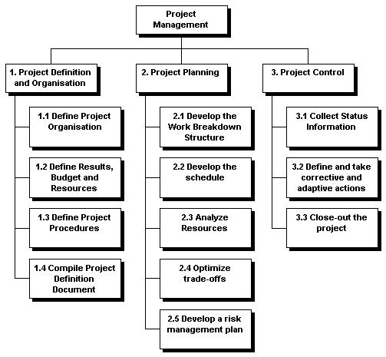
Project management in the DSE
DSE PM is simplified version of professional project management.
Example professional methodology:
Harvard University definition of PM
PM/SE WS-<number>

Slide 16
Project Management in the DSE
Student instructions
Use the Survival Kit for the Project plan contents and the principles of Project Management
Use Microsoft Project for your Gantt sheets
Update the planning and the Project definition part of the Project Plan during project execution
Remember
PM is a process so put its related tasks also in your planning
Projects need clear results (deliverables) to be obtained within a limited time and with limited resources (use Is/is not table to prevent ambiguity if necessary)
PM/SE WS-<number>

Slide 17
Project Management in the DSE
Project definition and organisation
To define a project and its organisation you need
An objective (POS, MNS),
Deliverables
A risk assessment
A team
Some rules for the team
A design and development logic
Coordinated actions assembled in a Gantt chart.
A Project Plan that reports item 1 to 6
Ad.5: Basic procedures like quality checks on reports, use of formats,
issuing etc., should be organised.
PM/SE WS-<number>

Slide 18
Project Management in the DSE
Project definition and organisation
The Project Objective Statement and Mission Need Statement should preferably:
  Be composed in 25 or fewer words (to force precision)
  Written in plain language, avoiding jargon and acronyms
  Be clear and concise
The Project Manager puts the POS and MNS together with the major deliverables and milestones in a document, which he makes available to project team members, the tutor and coaches.
Major deliverables, being central to a project's success, should be well defined and clearly understood. (for example using the ‘Is/Is Not’ Process)
PM/SE WS-<number>

Slide 19
Project Management in the DSE
Project definition and organisation
Take your time to agree on POS and MNS and try to make it as clear as possible. Ask your tutor for feedback on your interpretation of the project.
Go fast by starting slow!

Slide 20
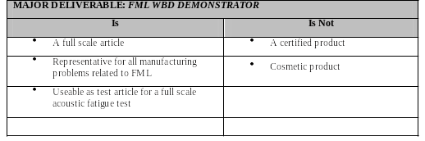
Project Management in the DSE
Example Is / Is Not Process:
PM/SE WS-<number>

Slide 21
Define project procedures
Project Management in the DSE
Actions to be taken in this step:
  Specify when and where the team will meet, who will attend meetings, and what topics will be discussed
  Establish attendance rules
  Establish participation guidelines
  Define report template
  Define document issue procedures (version control !!)
  Define planning procedures
  Define how to inform each other on changes and updates
  Get contact data clear
PM/SE WS-<number>

Slide 22
Project Management in the DSE
Project planning
Key steps in this set of activities:
  Develop Design & Development Logic (Work Flow Diagrams + explanation in clear text)
  Develop the Work Breakdown Structure
  Develop the Schedule
  Develop Risk Management Plans
PM/SE WS-<number>

Slide 23
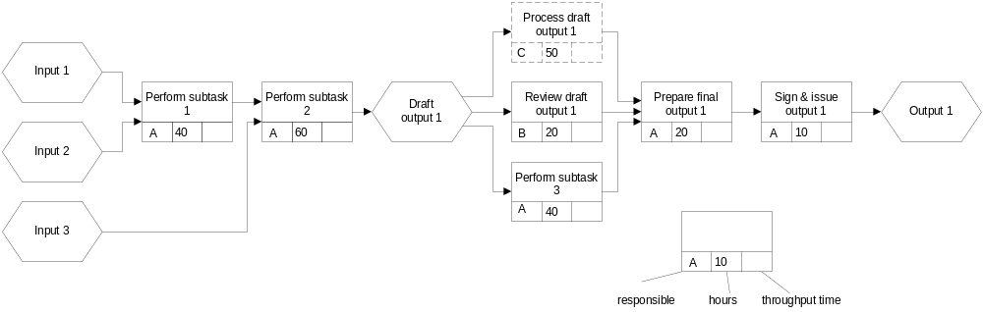
Some tools: Design & Development Logic
Work Flow Diagram
  Show activities (verbs) and deliverables (nouns) and their mutual relation
  Add attributes where useful
    Responsible,
    Effort (hours)
    Throughput time
PM/SE WS-<number>

Slide 24
How to make a flow diagram or a tree diagram
Write products, activities, elements, functions, etc. on separate “stickies” (PostIts)
Use, if necessary, different colors to distinguish different “units”
Paste the stickies on a large sheet of paper (e.g. flip over chart) in the order you think they should be
Shuffle the stickies until you are sure they are in the good order; produce additional stickies if you have forgotten something
Finally, draw the lines indicating the relation between the stickies
When finished, reproduce the final version with whatever means you want
Never try to make your diagram from scratch in one of those fancy drawing programs
  ⇒ The only guaranteed result is, that you waste mountains of time in non-creative activity
PM/SE WS-<number>

Slide 25
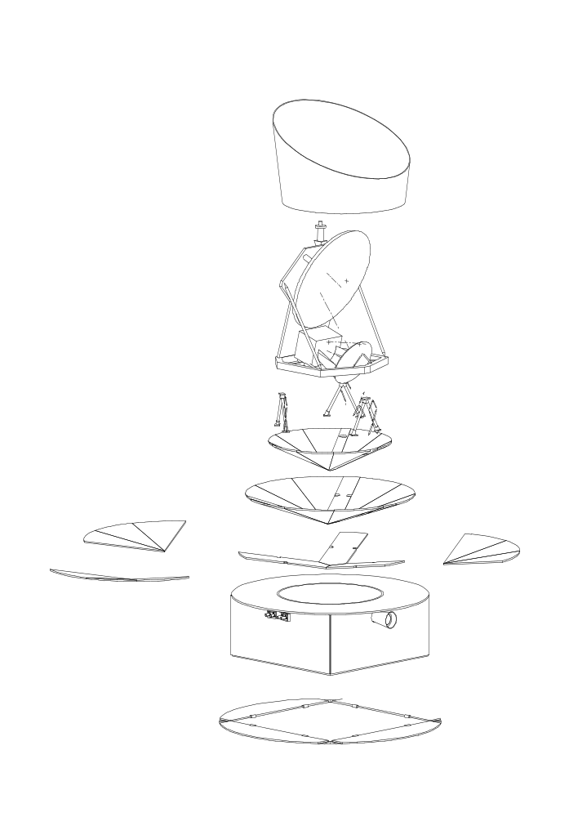
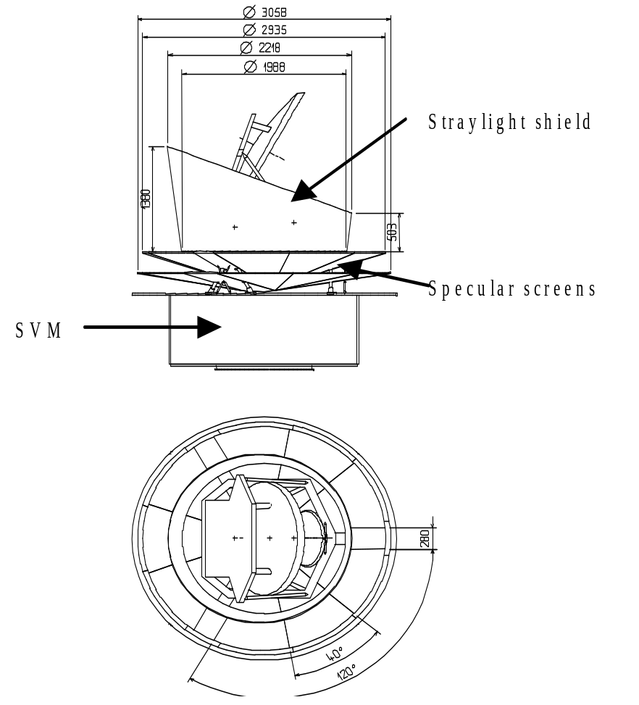
Example:
Planck Payload Module fast prototype
Beam direction
Slow spin
SVM: Service Module
sun
PM/SE WS-<number>

Slide 26
Example:
Project characteristics
Planck monitors back ground radiation of the (cold) celestial sky
Low heat flow to 0.2 K detectors required
400 wave guides connect cold detectors to warm spacecraft
Payload shall remain well aligned during integration, test, launch and operation
⇒ close interaction of structural, thermal and integration aspects of payload module is a feasibility issue: fast prototype to study this
PM/SE WS-<number>

Slide 27
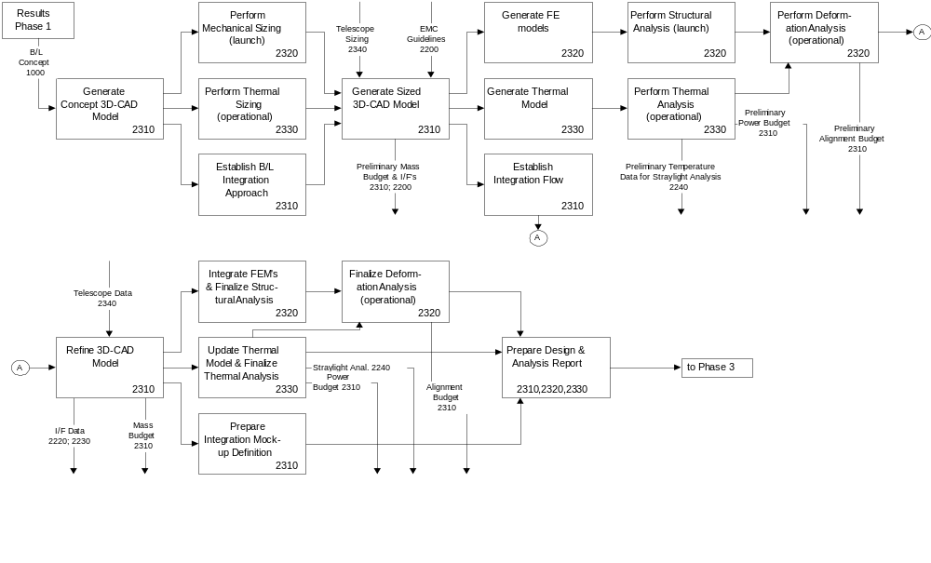
Example:
Work Flow Diagram
PM/SE WS-<number>

Slide 28
Work Breakdown Structure
Project Management in the DSE
The WBS is a hierarchical breakdown of all work required to achieve the scope portion of the project objective.
Actions to be taken in this step:
  Identification of all tasks/activities (Breakdown of the work packages)
  Include tasks as planning the project, approval cycles, testing,
  printing, etc.
  Estimate the time each task will take (in hours, days, months or whatever is appropriate)
  Assign owners to the lowest level tasks
  Try to have only one owner per task
This can all be done in Microsoft Project, including WBS coding,
etc.
PM/SE WS-<number>

Slide 29
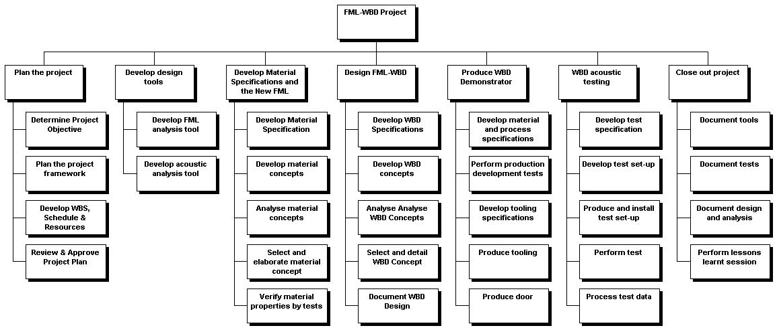
Project Management in the DSE
Work Breakdown Structure – Example:
It is subjective to make a distinction between Workpackages and Tasks
PM/SE WS-<number>

Slide 30
Develop the schedule
Project Management in the DSE
Actions to be taken in this step:
  Identify all dependencies between tasks (determined by the flow coming from the D&D-logic)
  Assign work estimates to the lowest level tasks
  Review with the team estimates for longer or more ambiguous tasks
  Create a Gantt Chart (includes milestone definition)
This can all be supported with Microsoft Project, including WBS coding,
checks on over-allocation, links between tasks, network diagrams etc.
The resulting planning must be agreed upon by the team! Agreement on what is expected, the activities required to meet the expectations and the time scheduled to get there
PM/SE WS-<number>

Slide 31
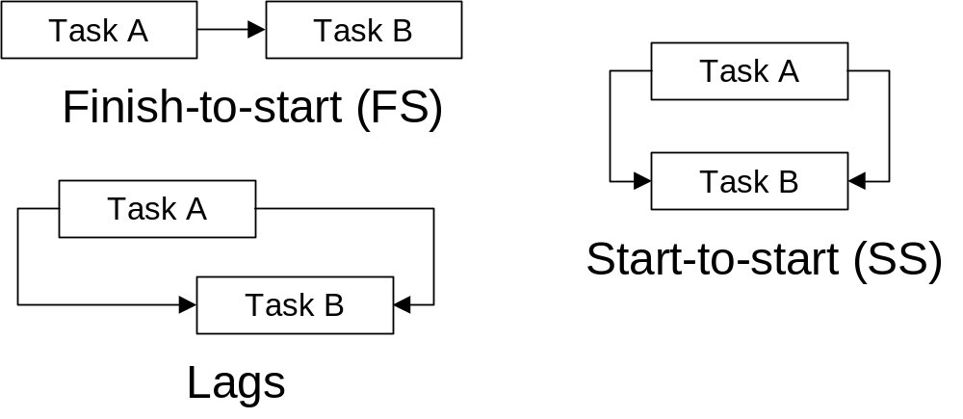
Intertask relationships
Project Management in the DSE
PM/SE WS-<number>

Slide 32
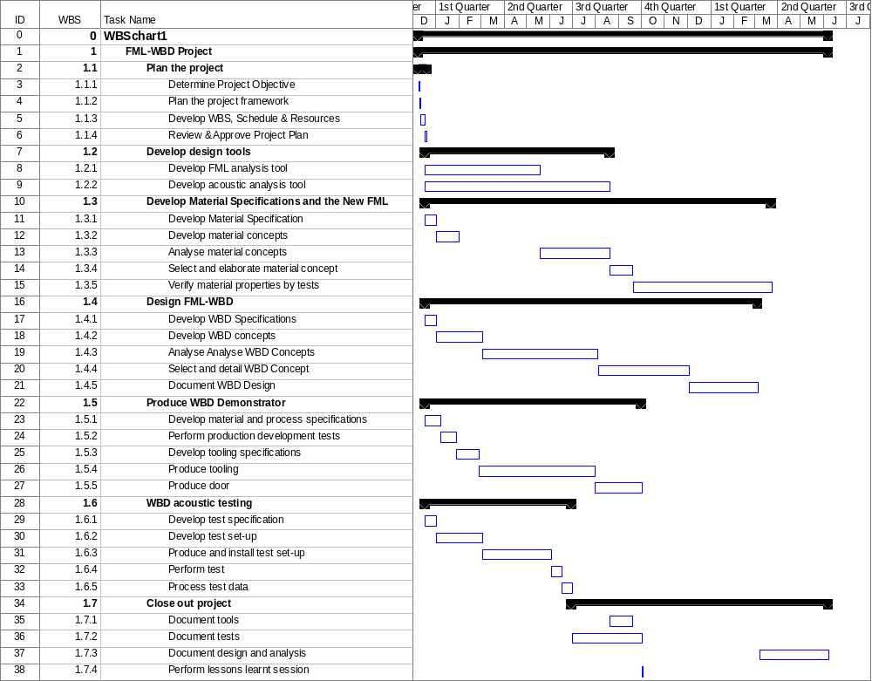
Gantt sheet example, made with
Microsoft
Project
Project Management in the DSE
PM/SE WS-<number>

Slide 33
Next step of schedule development: Analyse resources
Project Management in the DSE
Actions to be taken in this step:
  Check if no resource carries a disproportionate amount of workload
  Check if no resources are underutilized or overlooked
  Check if resources are affected by parallel work
  Check if all resources have the requisite skills to perform the work
The Gantt chart, with owners (resources) assigned, is one basis for informal resource analysis. A project manager and his team scan the Gantt chart looking for assignment pattern such as:
  The same owner listed as the owner of most tasks
  The same person listed as owner of several parallel tasks
  Some people seldom listed
  Many tasks stacked in parallel
  Ownerless tasks
PM/SE WS-<number>

Slide 34
Next step in schedule development: trade-offs between the project parameters: results, budget, resources
Project Management in the DSE
Actions to be taken in this step:
  Check if you are within the POS
  Check if the scope can be reduced/widened
  Check if a sequence can be changed
  Check if resources can be reassigned or more resources can be obtained
  Check if there is a better or smarter way to work and achieve the same result
Some common changes are:
  Move items in the Is/Is Not lists
  Eliminate one or more major deliverables
  Develop an alternative way to perform task work
  Alter dependencies
  Change resource allocations
  Accept new parameters
PM/SE WS-<number>

Slide 35
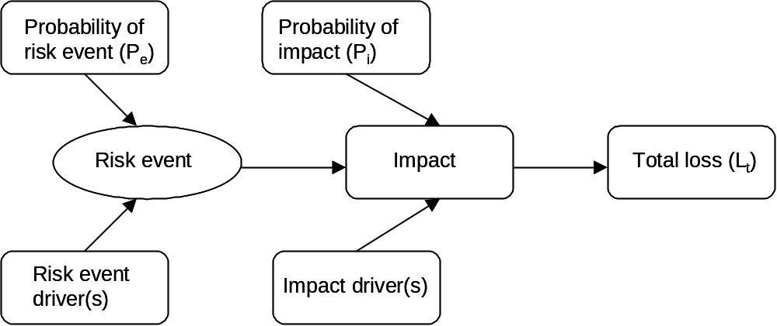
Develop a risk management plan (1)
Project Management in the DSE
A risk is the possibility that an uncertain event occurs that can influence the project in a negative way.
A risk always concerns an uncertainty, a potential loss and a time component.
Risk analysis assumes that risk events can be identified and that the probability of this event and the drivers that cause the event can be described.
Important (f)actors in risk analysis:
PM/SE WS-<number>

Slide 36
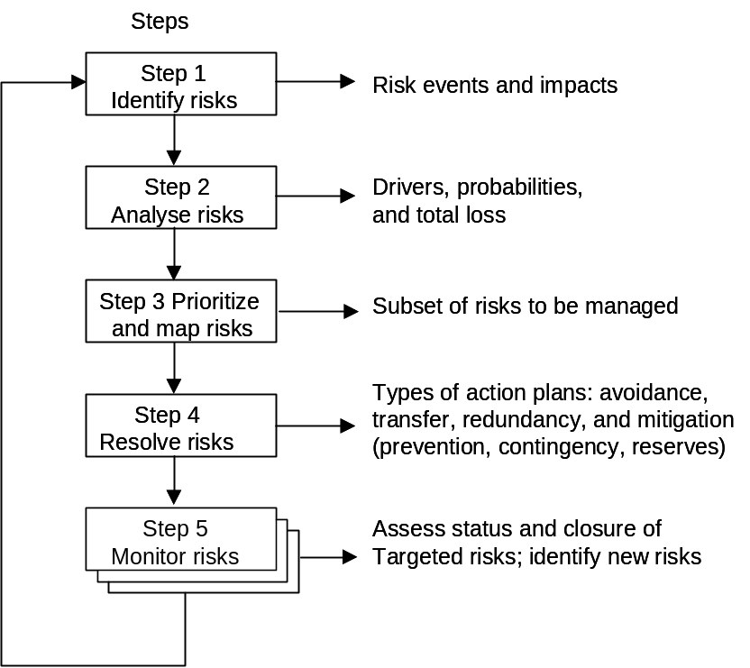
Develop a risk management plan (2)
Project Management in the DSE
Actions to be taken in this step:
  Identify risks
  Prioritize risks
  Take actions to reduce the
  probability of risk
  Formulate contingency plans
  Decide who is responsible
  for managing risk
The risk management process:
PM/SE WS-<number>

Slide 37
Develop a risk management plan (3)
Project Management in the DSE
Risk assessment and risk management are the two elements that should be part of each project.
Risk assessment consists of brainstorming to identify risks that might attend a project. Team members informally select the top two or three risks that present the greatest threat to the project and develop a plan to manage them.
Risk management plans should incorporate both actions that can be taken to reduce the likelihood of failure (i.e. preventive measures), and actions that can be taken in the event of failure (i.e. contingency plans).
PM/SE WS-<number>

Slide 38
Project Management in the DSE
Project control
Key steps in tracking and managing a project:
  Collect Status Information
  Plan and Take Adaptive Action
  and Close Out the Project
These should give project managers the information needed to:
  Keep key participants informed of progress
  Realign the project effort if necessary
  Use the learning from one project to improve the performance of the next
PM/SE WS-<number>

Slide 39
Project Management in the DSE
Project control
A good tracking systems collects status information on only three limited topics: schedule status, open issues, risks
Collect status information
  Decide how often information will be collected
  Decide how this information will be obtained
  Decide which information will be monitored
Plan and Take Adaptive Action
Key questions:
  What decisions will be made?
  What actions will be taken?
  How will these decisions and actions
  be communicated?
All actions become part of your project, thus part of the Gantt sheet. They should be managed like every other task.
PM/SE WS-<number>

Slide 40
Close out the project
Project Management in the DSE
Typical project close out activities include:
  Conduct a formal briefing
  Assessment of practices that contributed to the project’s effectiveness
  Assessment of practices that were not as effective as expected
  Development of process improvements for future projects
  Acknowledgement of team members’ contributions
  Completion of project paper work
  Archiving of the project file
  Celebration of the project’s completions
(Assessing effective and less-than-effective practices, developing process improvements, and celebrating a project’s successful completion often have a direct impact on efficiency in subsequent projects.)
PM/SE WS-<number>

Slide 41
Project Management items to be included in Design Synthesis Exercise Project Plan
Title Page
Table of Contents
  Mission Need Statement
  Project Objective Statement
  Work flow diagram / D&D logic
  Work Breakdown Structure
  Organogram
  Gantt chart
  Schedule risk assessment
  Basic team procedures
References (not included in page count)
Appendices (not included in page count)
20 pages max
PM/SE WS-<number>

Slide 42
DSE products for PM/SE
DSE Work Flow Diagrams | Functional Flow Diagram
DSE Work Break-down Structure | Functional Breakdown Structure
DSE Project Planning (= descriptive) | Requirements Discovery Tree
DSE Gantt Chart | Technical Resource (Allocation) Budgets
Team Organization / Organogram / HR Allocation | Technical Risk Assessment / Risk Map
Market Analysis | Design Option Structuring / Tree
Contingency Management | Project Design & Development Work Flow Diagrams
Design Option Strucutring /Tree | Project Gantt Chart
Trade Method, Rationale & Organization | Functional Flow Diagram & Functional Breakdown
Trade Criteria | Technical Resource Budgets (allocation & contingency)
Criteria Weight Factors | Technical Risk Assessment / Risk Map
Trade Summary Table | Cost Breakdown Structure & Cost Estimate
Technical Risk Assessment / Risk Map | Operations & Logistic Concept Description
Interface Definition / N² Charts | H/W and/or S/W Block Diagrams (interactions, flows)
Operations & Logistic Concept Description | Compliance Matrix
Project Plan; Mid-term Report
Baseline Report
Mid-term Report
Final Report
PM/SE WS-<number>
PM/SE outputs

Slide 43
When and where …
Product | PP | BR | MR | FR
DSE work flow diagrams
DSE work break-down structure
DSE project approach description
DSE Gantt chart
DSE team organization/organogram & human resource allocation
Functional flow diagram(s)
Functional breakdown
Requirements discovery tree & requirements structuring
Technical resource budgets (allocation & contingencies)
Technical risk assessment / risk map
Design option structuring (tree)
Market Analysis
P. 5
Use this list as an index when you submit
your report to your PM/SE coach
PM/SE WS-<number>

Slide 44
When and where … (2)
Product | PP | BR | MR | FR
Interface identification / N² charts
Trade method, rationale & organization
Trade criteria
Criteria weight factors
Trade summary table
Operations & logistic concept description
Project design & development work flow diagrams
Project Gantt chart
Cost break-down structure & cost estimate
H/W, S/W block diagrams (interactions, flows)
Compliance Matrix
Use this list as an index when you submit
your report to your PM/SE coach
PM/SE WS-<number>

Slide 45
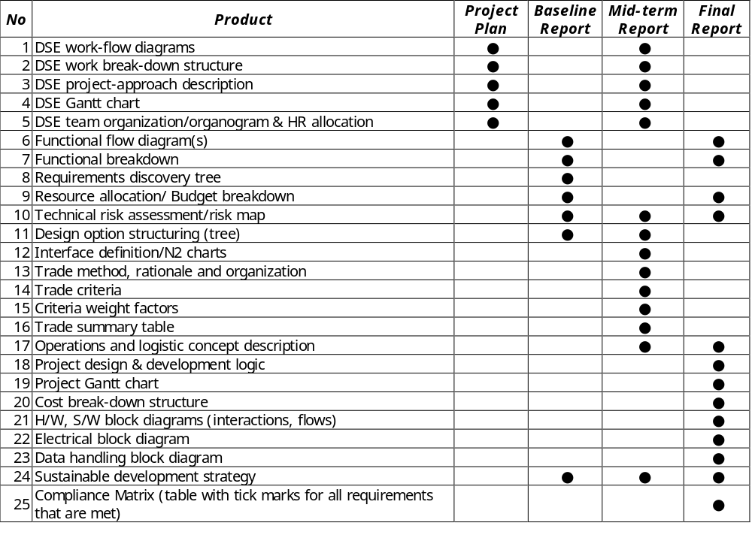
Obligatory SE Deliverables DSE 2010

Slide 46
Grading/evaluation by means of four checklists
Product | Present | Sufficient quality | Integrated in DSE
DSE work flow diagrams
DSE work break-down structure
DSE project approach description
DSE Gantt chart
DSE team organization / organogram & human resource allocation
Some additional “penalties” related to
  Bad documentation management
  Bad documentation quality
  Late delivery
  Inconsistency
PM/SE WS-<number>
PM/SE outputs

Slide 47
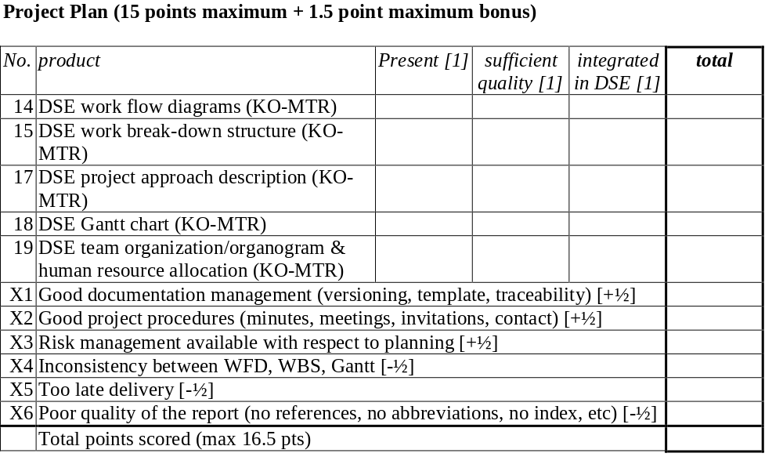
Grading PP

Slide 48
Coaching project teams
Workshop:
  Beginning of first week of DSE
PM/SE performance of teams will be judged based on one hard copy of the (draft)
  Project Plan (after 1 week)
  Baseline Report (if any)
  Mid-Term Report
  Final Report
On request of the project team meetings may be held for
  Feed back of report reviews (especially Baseline Report and Mid-Term Report)
  Steps to be taken in next phase (kick-off)
PT is welcome to attend !
PM/SE WS-<number>
PM/SE outputs

